Slide 1
BANK LOAN ANALYSIS USING POWER BI

Slide 2
Introduction
In this insightful analysis, we leverage cutting-edge data visualization to provide a detailed examination of loan performance, risk assessment, and financial trends. Through interactive dashboards and robust analytics, we aim to empower informed decision-making, enabling stakeholders to navigate the complexities of lending with confidence. Bank loans are a crucial financial tool that enables individuals and businesses to achieve their goals and manage financial needs. However, it’s essential for borrowers to understand the terms, costs, and responsibilities associated with loans to make informed financial decisions.

Slide 3
Problem Statement
In an era characterized by an exponential increase in data generation, the financial sector is undergoing a profound transformation driven by the need for data-driven decision-making. Within this landscape, bank loan analysis emerges as a critical area of focus, serving as the cornerstone of strategic planning, risk management, and performance optimization for financial institutions. This chapter provides a brief introduction to the project, outlining its objectives, and underscores the significance of bank loan analysis in the financial sector.

Slide 4
Objective
The primary objective of this project is to leverage the capabilities of Power BI to conduct a comprehensive analysis of bank loans. By utilizing Power BI's advanced visualization and analytics features, we aim to gain insights into various aspects of loan portfolio performance and borrower characteristics. The project encompasses data collection, preprocessing, analysis, and visualization, culminating in the creation of interactive dashboards that provide stakeholders with actionable insights for strategic decision-making.

Slide 5
Significance of Bank Loan Analysis in the Financial Sector
Bank loan analysis holds immense significance in the financial sector due to its crucial role in assessing credit risk, optimizing loan portfolio performance, and informing strategic decision-making. By analyzing loan data, financial institutions can identify trends, patterns, and potential risks within their portfolios, enabling them to mitigate losses, enhance profitability, and ensure regulatory compliance.

Slide 6
Effective Bank Loan Analysis enables Financial Institutions to:
Evaluate borrower creditworthiness
Monitor loan portfolio performance
Optimize loan portfolio composition
Support strategic decision-making

Slide 7
Methodology
Bank Loan analysis requires a robust methodology encompassing data collection, preprocessing, and analytical techniques to derive meaningful insights.
Data Collection Process
Data Preprocessing, Cleaning, and Transformation
Data Cleaning: Removal of Duplicates, Handling Missing Values, Outlier Detection.
Data Integration: Harmonization, Unification, Standardization.
Feature Engineering: Insight Generation, Complexity Reduction, Transformation.
Data Transformation: Standardization, Encoding Categorical Variables, Feature Engineering.

Slide 8
Methodology
3. Analytical Techniques for Bank Loan Analysis:
Descriptive Analysis
Predictive Modelling
Segmentation Analysis
Financial Ratio Analysis
Time-Series Analysis
Probability of Default (PD) Modeling
Portfolio Optimization
By employing these methodologies and techniques, we were able to conduct comprehensive bank loan analysis, identify key risk factors, and optimize lending strategies to achieve desired business outcomes.

Slide 9
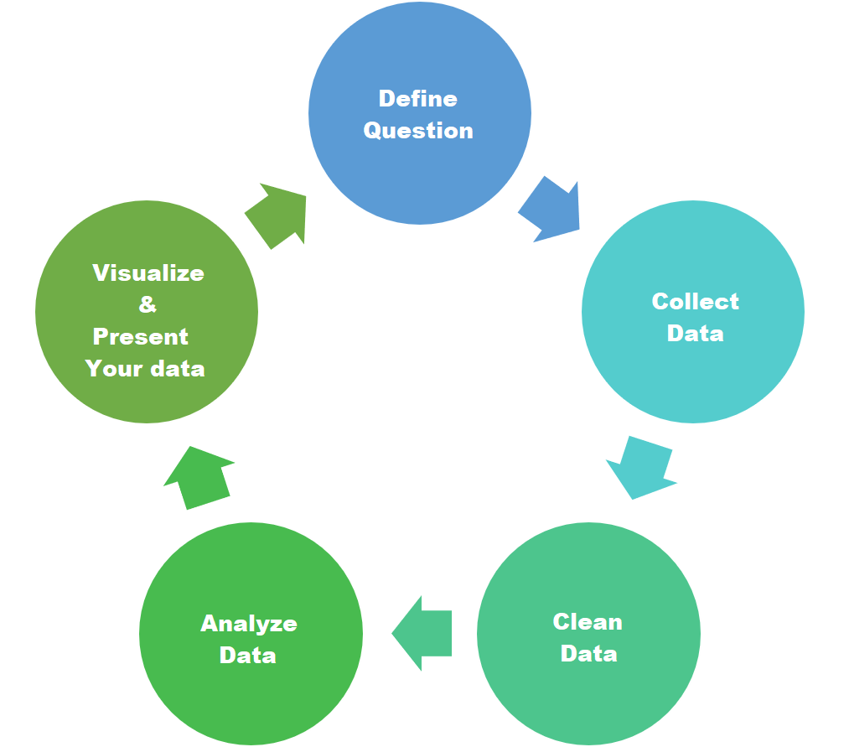
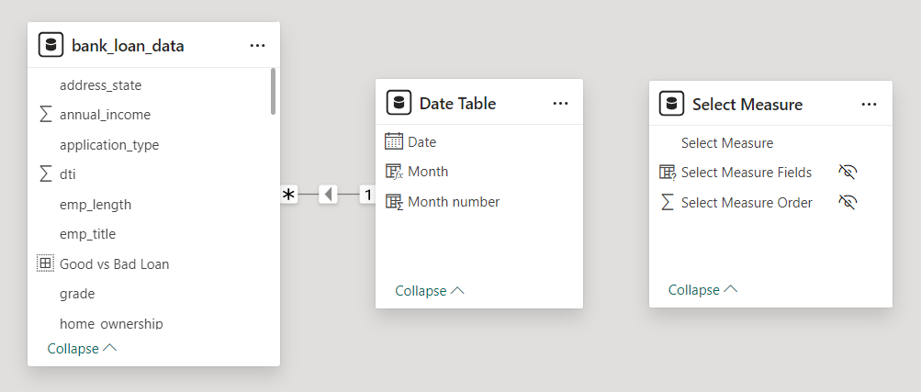
Methodology

Slide 10
Implications for the Banking Industry
Risk Management
Customer Segmentation
Market Expansion
Operational Efficiency

Slide 11
Limitations and Constraints
Data Quality
Model Assumptions
Regulatory Compliance
By addressing these limitations and constraints, banks can enhance the robustness and reliability of their loan analysis processes and leverage data-driven insights to drive strategic decision-making and optimize loan portfolio management strategies.

Slide 12
Conclusion
Summary of Findings:
Loan Portfolio Performance
Borrower Characteristics
Geographic Variations
Granular Insights
Significance of the Project:
Enhanced Risk Management
Improved Customer Segmentation
Operational Efficiency

Slide 13
Areas For Further Research or Improvement
Advanced Analytics
Data Integration
Regulatory Compliance
Real-Time Monitoring
By embracing technology and data-driven approaches, banks can enhance their risk management practices, improve customer satisfaction, and drive operational efficiency in the ever-evolving financial landscape.

Slide 14
References
1. Altman, E. I. (1968). Financial ratios, discriminant analysis and the prediction of corporate bankruptcy. *Journal of Finance*, 23(4), 589-609.
2. Basel Committee on Banking Supervision. (2010). Basel III: A global regulatory framework for more resilient banks and banking systems. Bank for International Settlements.
3. Microsoft. (n.d.). [Power BI Documentation]
4. Moody's Analytics. (2020). [RiskCalc™ Credit Risk Modeling and Validation]
5. RStudio Team. (2020). [RStudio: Integrated Development for R]
6. U.S. Securities and Exchange Commission. (2020). [EDGAR - Electronic Data Gathering, Analysis, and Retrieval]
7. World Bank. (2020). [World Bank Open Data]
9. Market Trends Report 2023: ABC Financial Services.

Slide 15
Thank You

